Slide 1

AML-2304 Natural Language Processing
Lambton College
School of Computer Studies
[Prepared By: Vahid Hadavi, PhD]

Slide 2

Learning Outcomes
Evaluate the key concept of Natural Language Processing (NLP)
Evaluate the application of NLP in various Canadian businesses
Explain Text Wrangling and Cleansing
Illustrate Text Classification
Hyper-V Role
Evaluate Sentiment Analysis
Discriminate Parsing Structure in Text
Evaluate Sentiment Analysis using Python NTLK (Natural Language Toolkit) library
Demonstrate Files operations in Python
Evaluate Word2Vec Algorithm

Slide 3
Required Materials
Text Book (Not required but a good reference)
Natural Language Processing: A Quick Introduction to NLP with Python and NLTK
Samuel Burns
ISBN-13: 978-1079244311
155 pages
Release Date: 8 July 2019
Published by: Independently published

Slide 4
Review Policies
Late assignments/exams
Standard College Policy

Slide 5
Evaluation
Evaluation methods
Evaluation Method | Weight
Midterm - 20% | 20%
Final - 20% | 20%
Assignments | 20%
Final Term Project | 40%
Total | 100%
2. Marking Scheme
Mark(%) | Grade | Mark(%) | Grade
94-100 | A+ | 67-69 | C+
87-93 | A | 63-66 | C
80-86 | A- | 60-62 | C-
77-79 | B+ | 50-59 | D
73-76 | B | 0-49 | F
70-72 | B-

Slide 6
Any questions so far? Any comments?

Slide 7
Module 1 1. Evaluate the key concept of Natural Language Processing (NLP)
Major Topics:
1.1 Define Natural Language Processing
1.2 Describe the Challenges of NLP; extraction of meaning from text
1.3 Discuss the importance of Natural Language Processing

Slide 8
1.1 Define Natural Language Processing

Slide 9

Natural Language Processing
Definition
English, Chinese, Spanish are natural languages
Python, Java are artificial languages
Natural language processing is any computation, manipulation of natural languages to get insights
Natural Language Processing is a subfield of Artificial Intelligence.
Main goal
Computer reads, deciphers and understands the human languages, and acts based on its understanding.

Slide 10
Natural Language Processing
History
World War 2; Idea came to existence for creating a machine that translates
Up to the 1980s; NLP systems were based on complex hand-written mathematical rules.
Late 1980s; a revolution in NLP with the introduction of machine learning (ML) algorithms for language processing.
Recent years; a significant breakthrough in NLP due to the emergence of the subfield of ML called Deep Learning (DL).
NLP on Python
In NLP, full automation is achieved using modern software libraries and packages.
Natural Language Toolkit (NLTK), a platform used for building Python programs that work with human language data for applying in statistical NLP.
Written by Steven Bird and Edward Loper at the University of Pennsylvania in 2001.

Slide 11
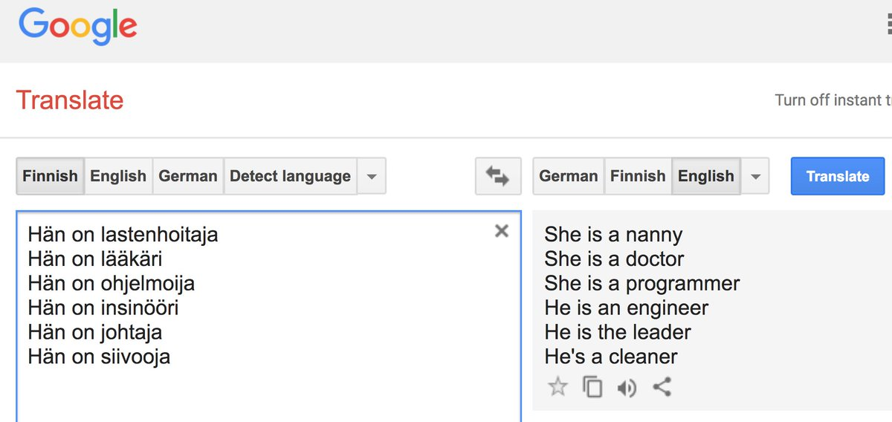
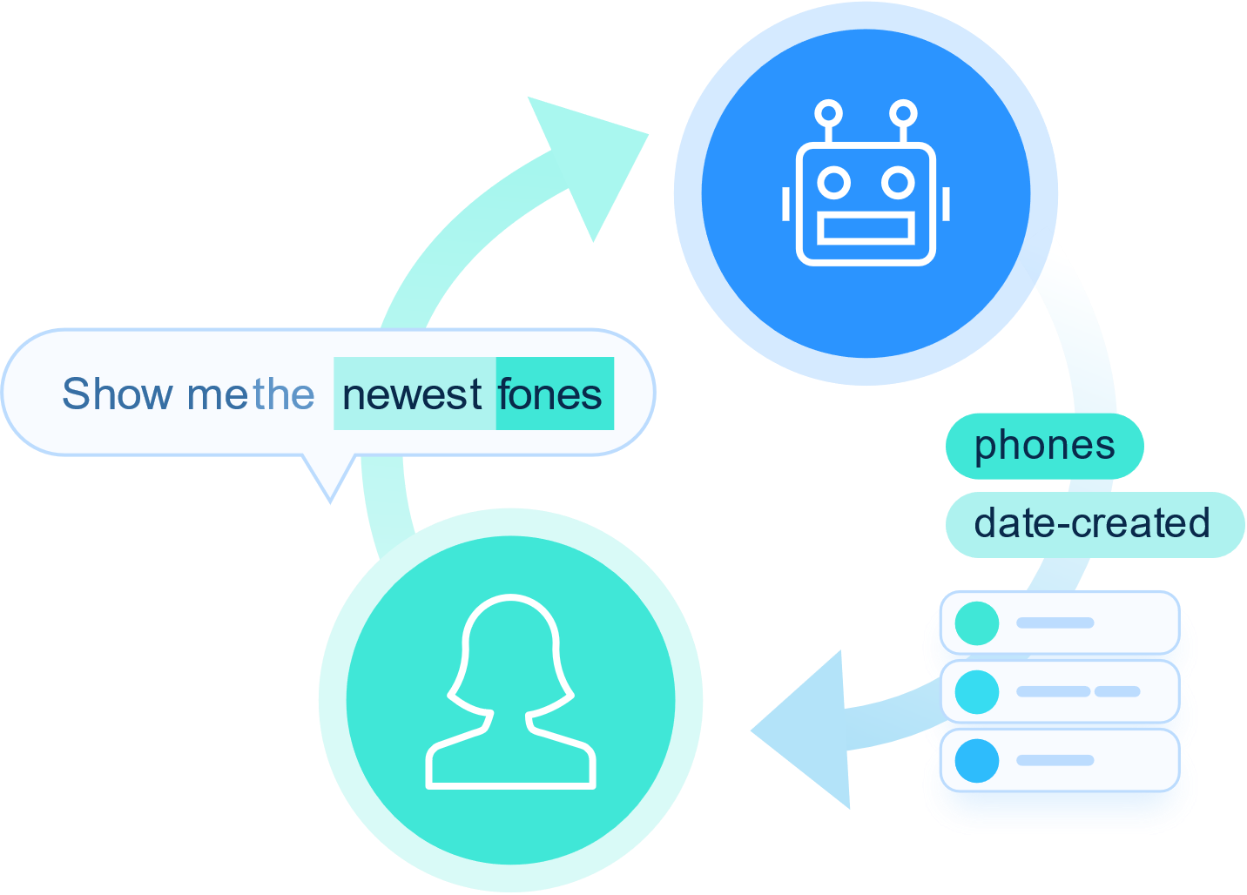


NLP Applications
Translation
Sentiment analysis
Search engine
Spam filtering

Slide 12




NLP Applications
Banking Fraud detection
Information extraction
.
Question answering
Healthcare

Slide 13
1.2 Describe the Challenges of NLP; extraction of meaning from text

Slide 14
Data-related challenges
Low resource languages
To train computers to understand a natural language, many data resources are required:
A high amount of raw text from various genres; books, scientific papers, etc.
Lexical, syntactic and semantic resources; dictionaries, dependency tree corpora, etc.
There are more than 7000 natural languages.
More than 1000 languages alone in Africa with very low resources.
Dealing with large or multiple documents
Hard to read entire books and movie scripts.
Current models cannot represent longer contexts well.

Slide 15
Natural Language Understanding
Ambiguity
Lexical ambiguity; words have different meanings:
“I saw a bat”
Syntactic ambiguity; a sentence has multiple parse trees:
“I shot the man with the ice cream”
Intention, emotions
Intention and emotion depend on author’s personality.
People use different styles to express the same idea.
Irony or sarcasm may convey a meaning that is opposite to the literal one.
A man with the ice cream was shot.
I shot the man with my ice cream.

Slide 16
Natural Language Understanding
Synonymy
we can express the same idea with different terms:
Big & Large
Coreference
coreference resolution; the process of finding all expressions that refer to the same entity in a text.
“Tom dropped the glass jar by accident and broke it”
Important step for a lot of higher-level NLP tasks; document summarization, question answering
In some contexts they can be interchangeably used.
In some contexts they cannot be interchangeably used.
.
What does it refer to?

Slide 17
1.3 Discuss the importance of Natural Language Processing

Slide 18

Why NLP is important?

Slide 19
Why NLP is important?
Handling large volumes of text data
With the big data technology, NLP has entered the mainstream as this approach can now be applied to handle large volumes of text data via cloud/distributed computing at an unprecedented speed.
Imagine you’re given a sentence and tasked to identify if this sentence has positive/negative/neutral sentiment, manually.
Imagine now you’re given millions of sentences and perform the sentiment analysis again. How long would that take you?
Structuring highly unstructured data source
Describing text data as unstructured data is an understatement..
NLP helps to structure texts and add convert them to numerical structures
Text data is a mess

Slide 20
Any questions so far? Any comments?

